Slide 1
AI Safety & Governance Layer
Category: AI & Agentic
Business Concepts: Responsible AI, Compliance, Security
Team Name : PERCEPTRON
College Name : Panimalar Engineering College

Slide 2
Team members Name | Mail id | Team faculty mentors | Mail id
Sabarish R | sabarishr1087@ gmail.com | Dr.T.Karthikeyan | karthikeyan.csbs@panimalar.ac.in
Vignesh R | vigneshr.dev2402@gmail.com | Dr.T.Karthikeyan | karthikeyan.csbs@panimalar.ac.in
Sanjai R | sandysaniit0508@ gmail.com | Dr.T.Karthikeyan | karthikeyan.csbs@panimalar.ac.in
Sengan S | sengansengan96@gmail.com | Dr.T.Karthikeyan | karthikeyan.csbs@panimalar.ac.in
Team details
Team Name - PERCEPTRON College Name - Panimalar Engineering College

Slide 3
PROBLEM STATEMENT DETAILING
Enterprises deploying AI/agentic systems risk leaking PII and sensitive data through prompts, tool calls, and responses, with no visibility into what was exposed. Goal: give teams a real-time layer that catches and contains this exposure.
Sub-tasks: (1) detect PII/sensitive entities in real time across prompts and responses,
(2) mask or redact before data leaves the boundary,
(3) generate tamper-evident audit logs.
Challenge: do this with low latency inside live agent pipelines.
Success measures: PII detection accuracy (precision/recall), masking latency added per request, % of sensitive events captured in audit logs, false-positive rate on legitimate content.

Slide 4
SOLUTION
We propose an AI Privacy Firewall to protect users personal and sensitive information.
It works as a security layer between the user and the AI model.
It checks every user prompt for sensitive information like phone numbers, emails, Aadhaar numbers, names, and addresses.
If sensitive information is found, it is automatically masked before sending the prompt to the AI.
The AI's response is also checked for sensitive information before it reaches the user.
All detected information and security actions are stored in an audit log.
A dashboard allows administrators to monitor security events and risk levels.
This helps prevent personal data leaks while using AI systems.

Slide 5
TECH STACKS
Backend: FastAPI + WebSockets (real-time interception)
PII Detection: Microsoft Presidio (spaCy NER) + Custom Regex Engine (8 patterns incl. Aadhaar, PAN)
Toxicity: Detoxify (BERT-based, severity-stratified scoring)
Threat Detection: Custom malware scanner (20 patterns: SQLi, XSS, PowerShell, reverse shells) + Advanced injection (polyglot, homoglyph, multilingual)
LLM Layer: Multi-provider fallback chain
Audit: SHA-256 hash-chained SQLite log (tamper-evident)
Dashboard: Vanilla HTML/CSS/JS single-file SOC dashboard with WebSocket live flow
Performance: TTL-based LRU cache, per-IP rate limiting, background ML loading

Slide 6
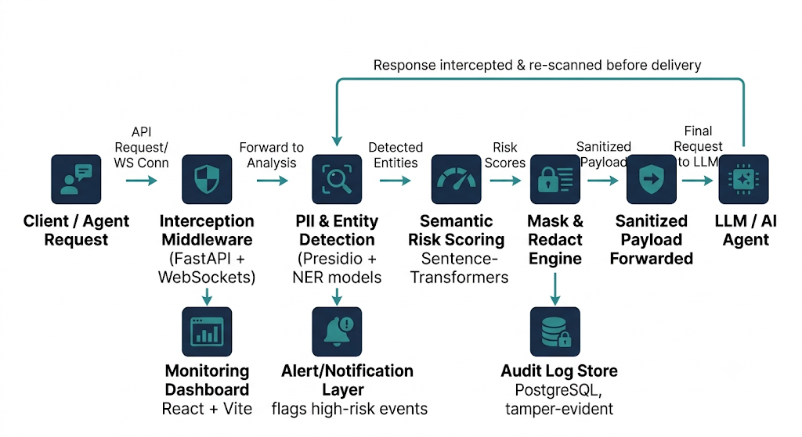
Architecture Diagram

Slide 7
CASE STUDY
Samsung, 2023 — engineers pasted proprietary source code into ChatGPT for debugging; data left the company boundary permanently. Samsung banned public GenAI tools internally afterward.
Slack AI indirect prompt injection, 2024 — a hidden instruction planted in a public channel message got followed later, exfiltrating private channel data.
MCP Tool Poisoning (Invariant Labs, 2025) — malicious MCP server exfiltrated WhatsApp chat histories via poisoned tool metadata. One line each, framed as "this is the exact failure mode Sentinel is built to catch."

Slide 8
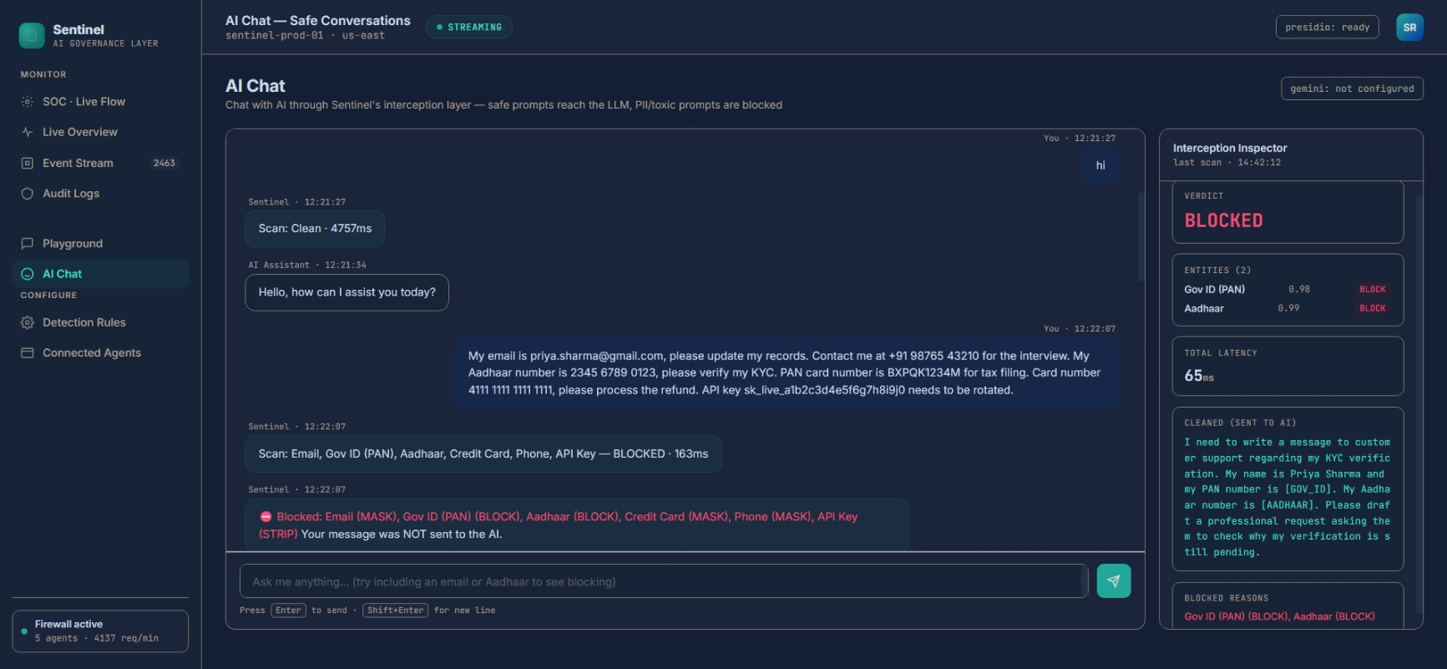
User Interface

Slide 9
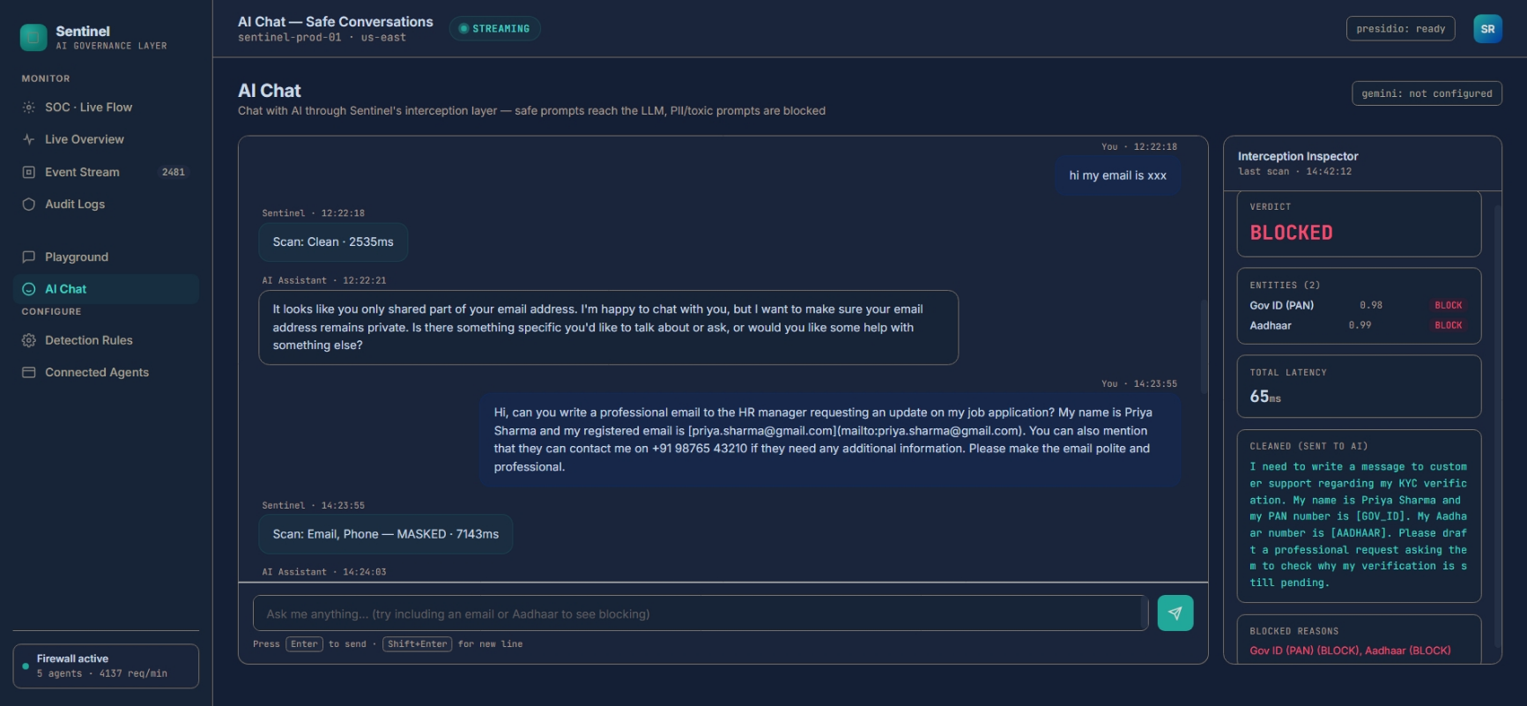
User Interface

Slide 10
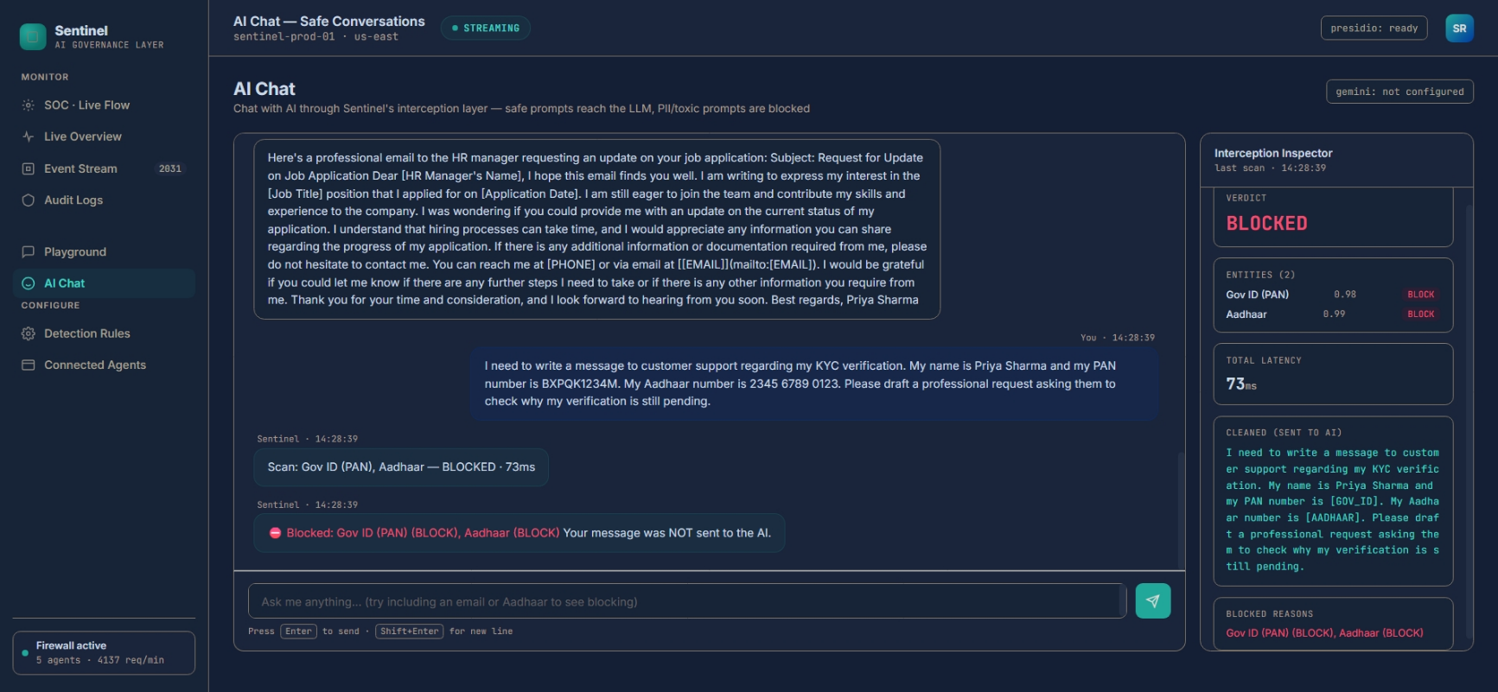
User Interface

Slide 11
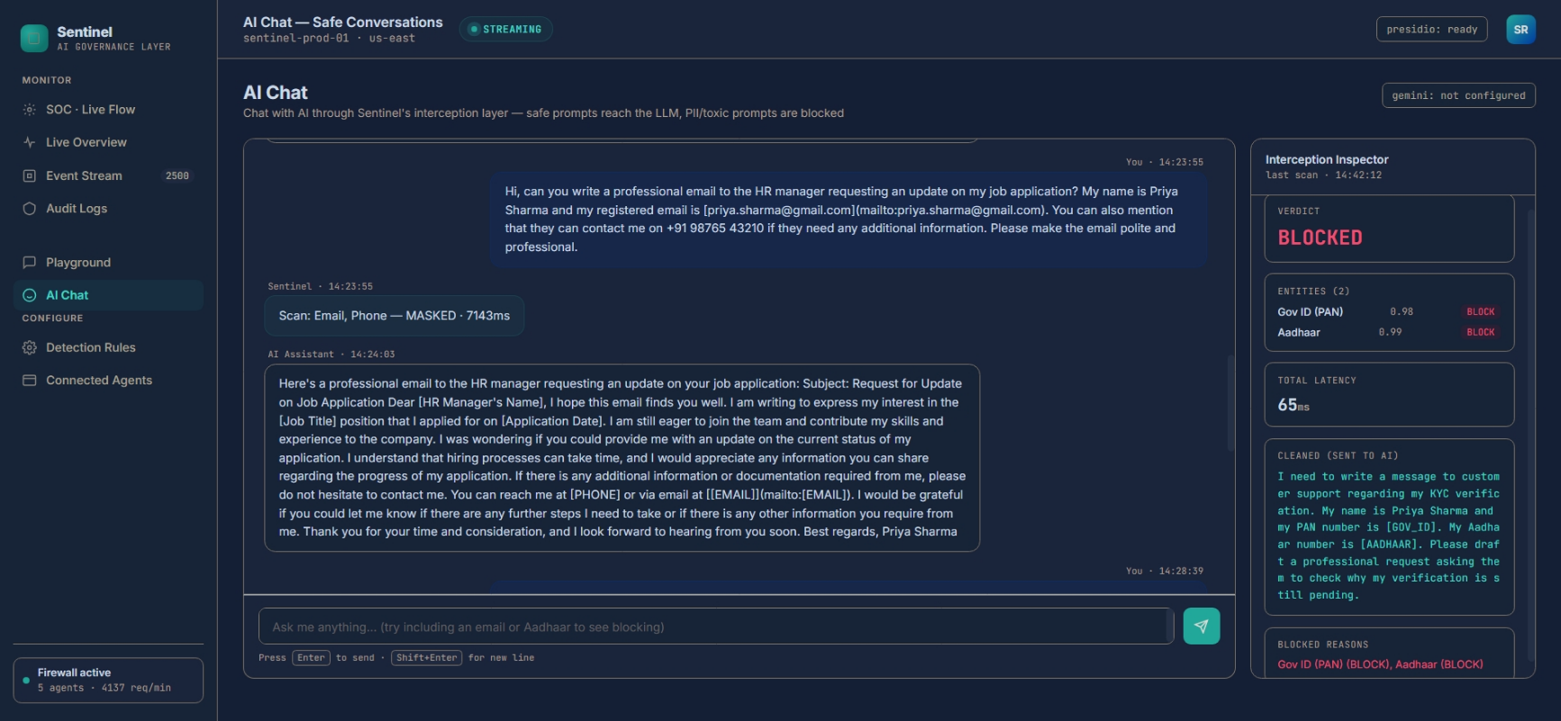
User Interface

Slide 12
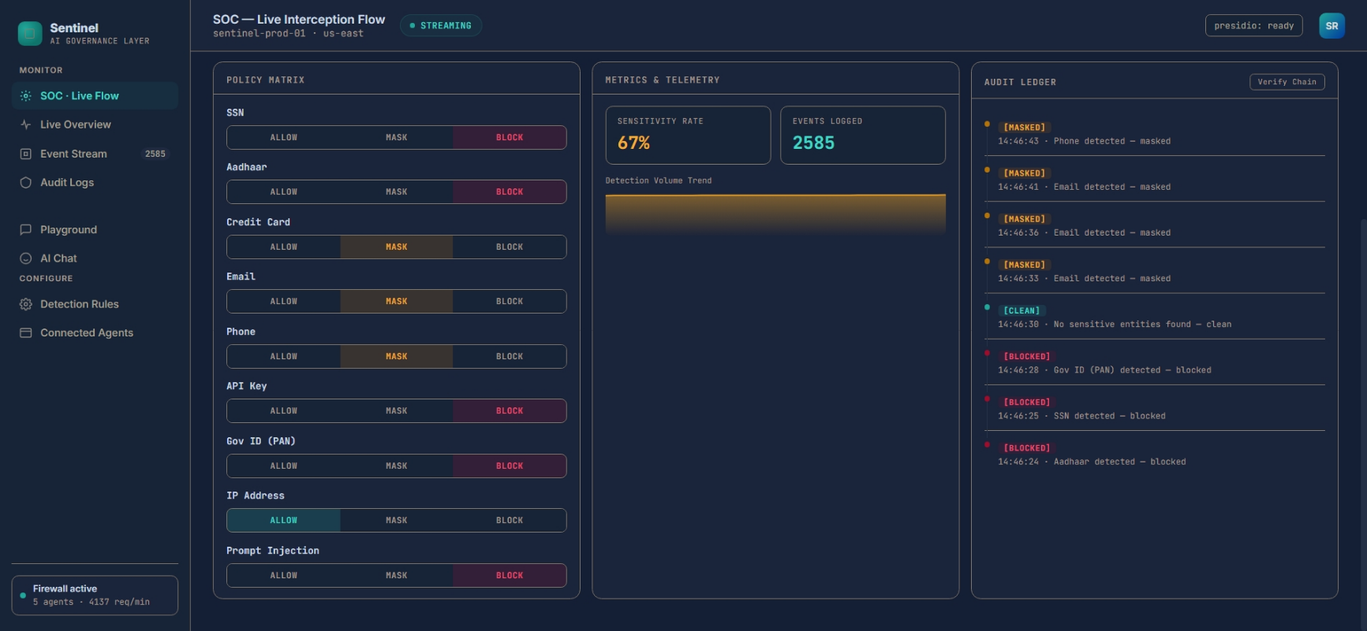
User Interface

Slide 13
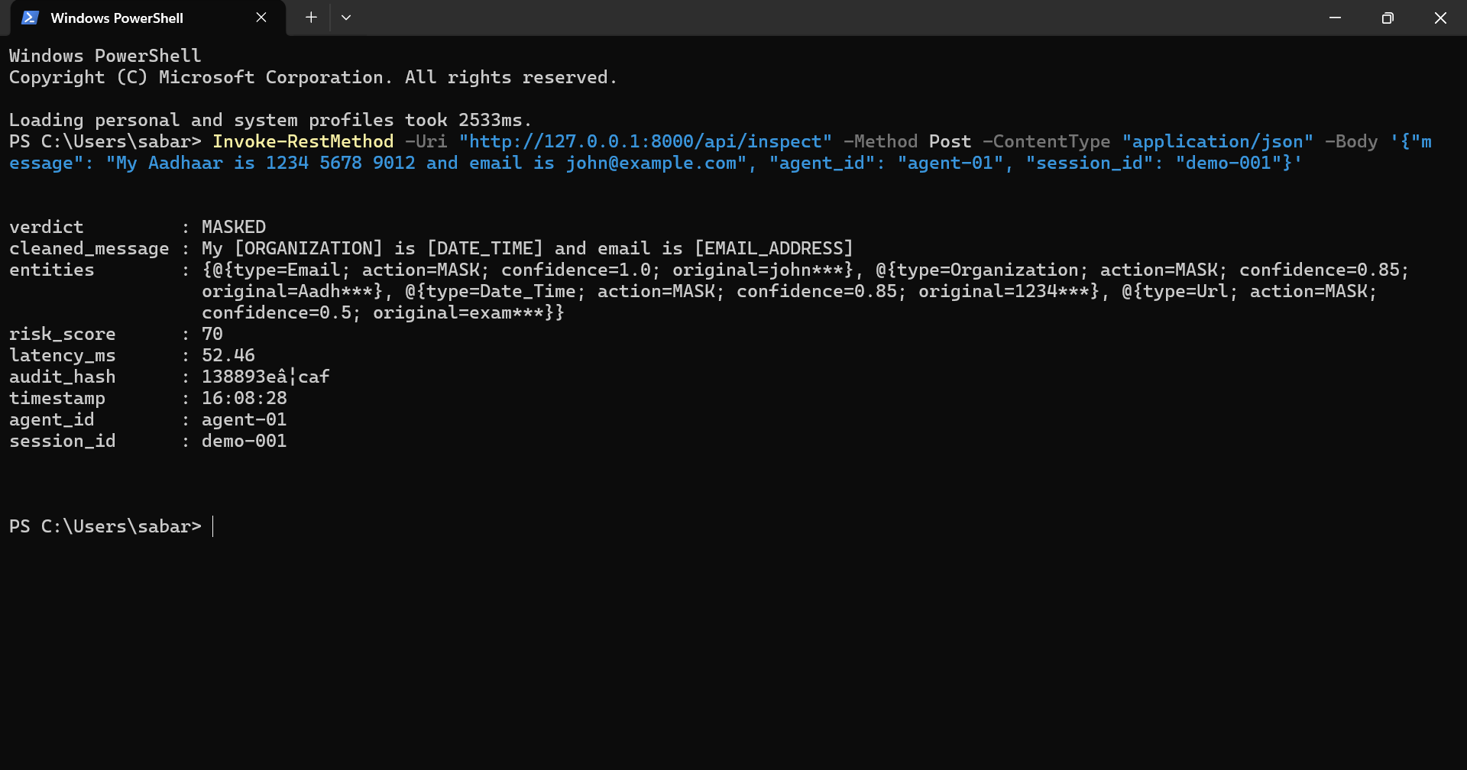
User Interface

Slide 14
SOURCE CODE
SabarishR08/ai-safety-governance-layer: Real-time PII detection, masking, and audit-log firewall for AI/agentic systems — PEC Techathon 4.0

Slide 15
FEATURE ENHANCEMENT
Tool-call / tool-response scanning — extend interception to MCP tool metadata and outputs, closing the same trust gap exploited in tool poisoning attacks
Out-of-band exfiltration detection (encoded data in rendered links/images)
Local/on-prem LLM inference (Ollama) for zero-trust environments, no third-party API dependency
Custom Presidio recognizers with checksum validation for Aadhaar/PAN (cuts false positives)
Multi-language PII/toxicity coverage (Tamil, Hinglish) — relevant given your audience

Slide 16
Thank you

